Slide 1


Einstein, what’s the smartest way to get you to our customers?
Employee Agents custom prompt edition #se-edition

Slide 2
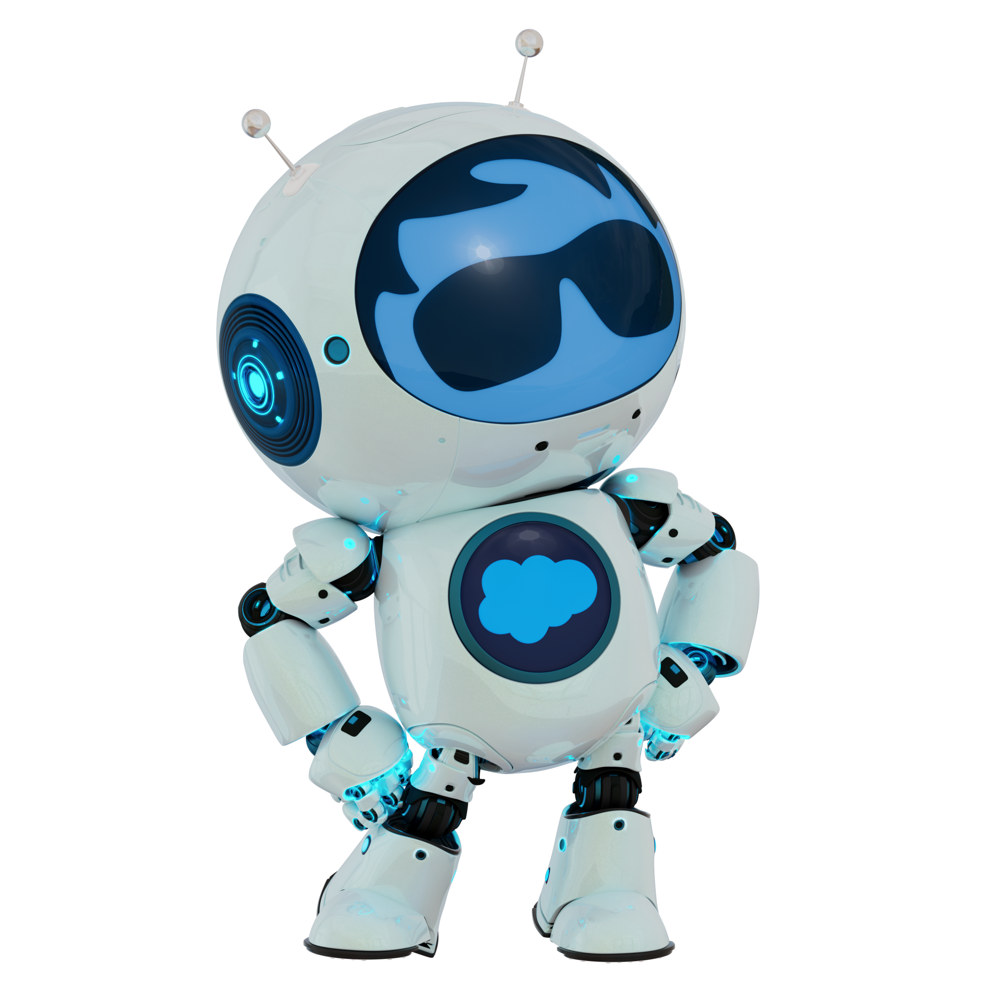
Custom Build Prompt Library
Plan my day
Account Research
Sales Methodology focussed Oppty Coach
Create Service Summary
Visit Report with Voice Transcript and Actions
Exec View on Account
Einstein DQ Inspector

Slide 3
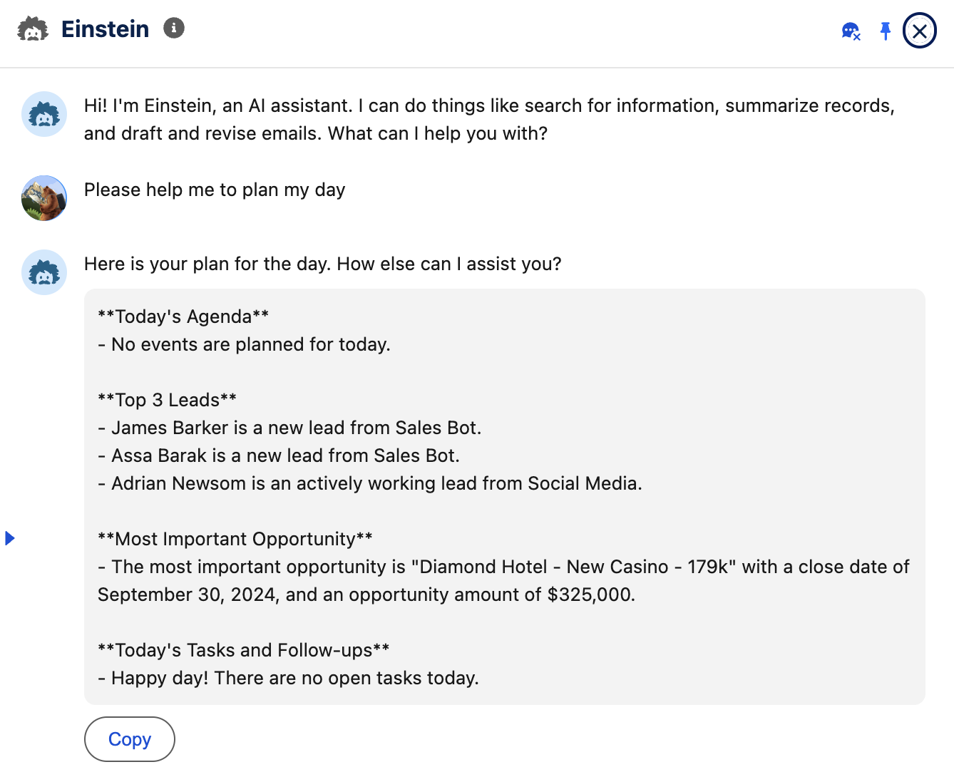
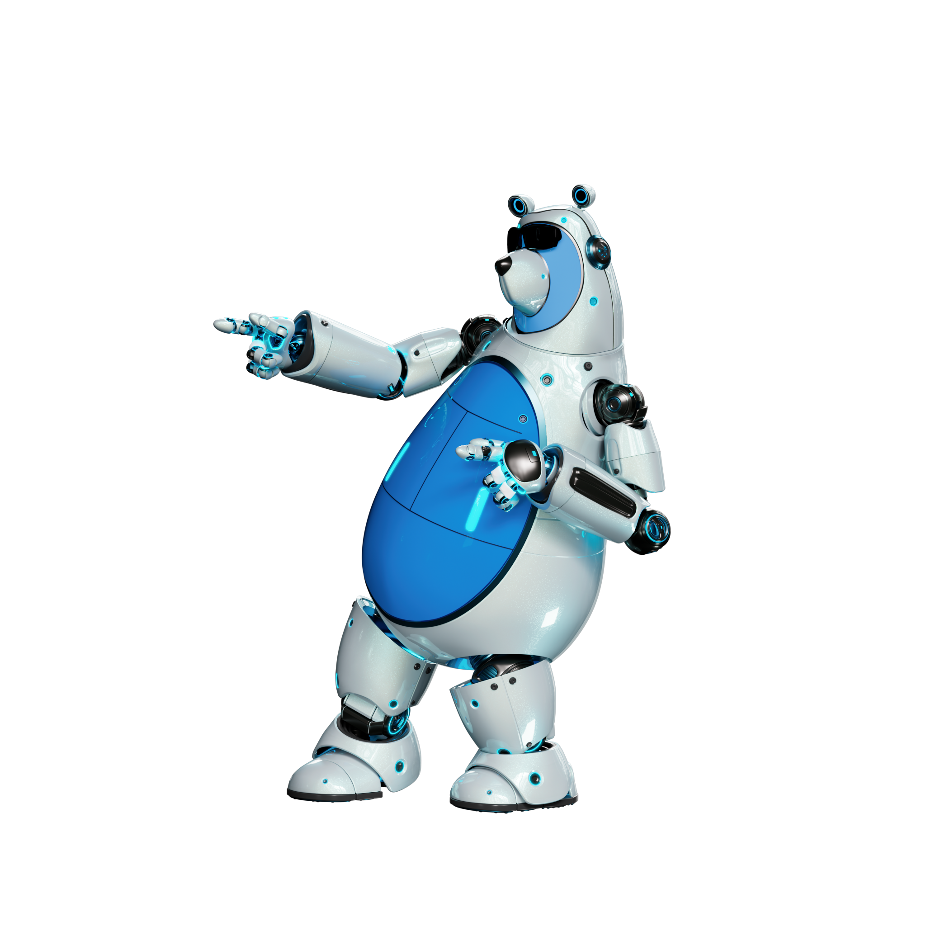
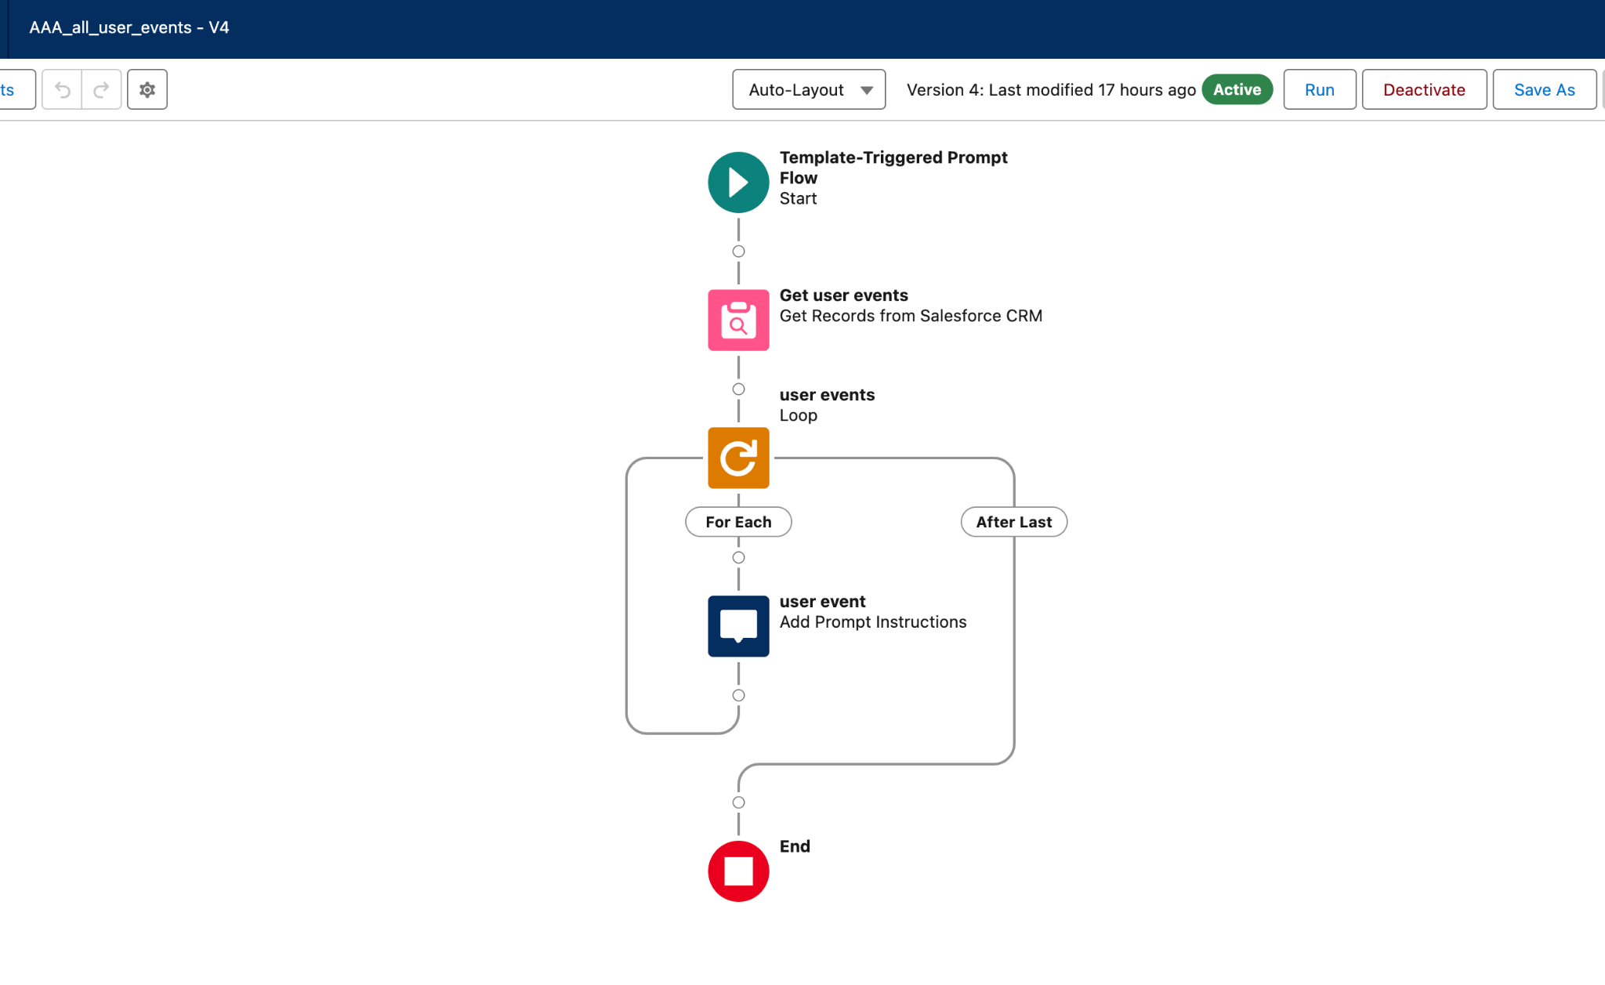
Plan my day
Ansprechpartnerin: Bettina van der Stelt
Overview
live screenshot
Short Description
Start in the day right! Ask Einstein to plan your day, getting an instant overview about:
scheduled events
top leads
top opportunity
tasks & follow ups
Simplifying where to actually focus on right at the beginning of the day! Maybe followed by the standard action ‘create close plan’ to get started step-by-step.
How to build it?
Please find full prompt in speaker note & detailed screenshots of all flows etc. beneath
Notes:
Generate a brief agenda for a sales rep working at {!$User.CompanyName} to help plan his day. The agenda should be precise, in short sentences and consist out of 4 topics, each topic should be displayed in bold.
The first topic is: Today's agenda
Here meetings and event's of the sales should be shown in timely order and short bullets, highlighting the name, time and description of the event. If no event is planned for the day, please highlight that there is no event.
Events:
{!$Flow:AAA_all_user_events.Prompt}
Second topic: top 3 leads
For this topic, return the most important 3 leads, take into account the following rules to determine relative importance:
1. Only leads in stage1-new or 2- working are interesting
2. The more engaged the lead is the more important he is
3. The higher the einstein lead scoring is the more important he is
Introduce every lead with one short sentence and link the lead to the name.
Leads:{!$Flow:AAA_Get_user_leads.Prompt}
Third topic: Most important opportunity
For this topic, return the most important opportunity, take into account the following rules to determine relative importance
1. The higher the amount the more important an opportunity is
2. The closer the close date to the current is the more important an opportunity is, close date should be in September 2024.
3. Opportunities with a close date in the past are never important.
4. If you can't find an opportunity, display 'there is no opportunity'
Opportunities:
{!$Flow:Get_Open_Opportunities_for_User.Prompt}
Fourth topic: Today's Task's and follow-ups
Todays tasks and follow ups should be shortly listed, if there are no tasks for the day then please state: 'happy day! There are no open tasks today!'
Tasks: {!$Flow:AAA_user_tasks_of_today.Prompt}

Slide 4
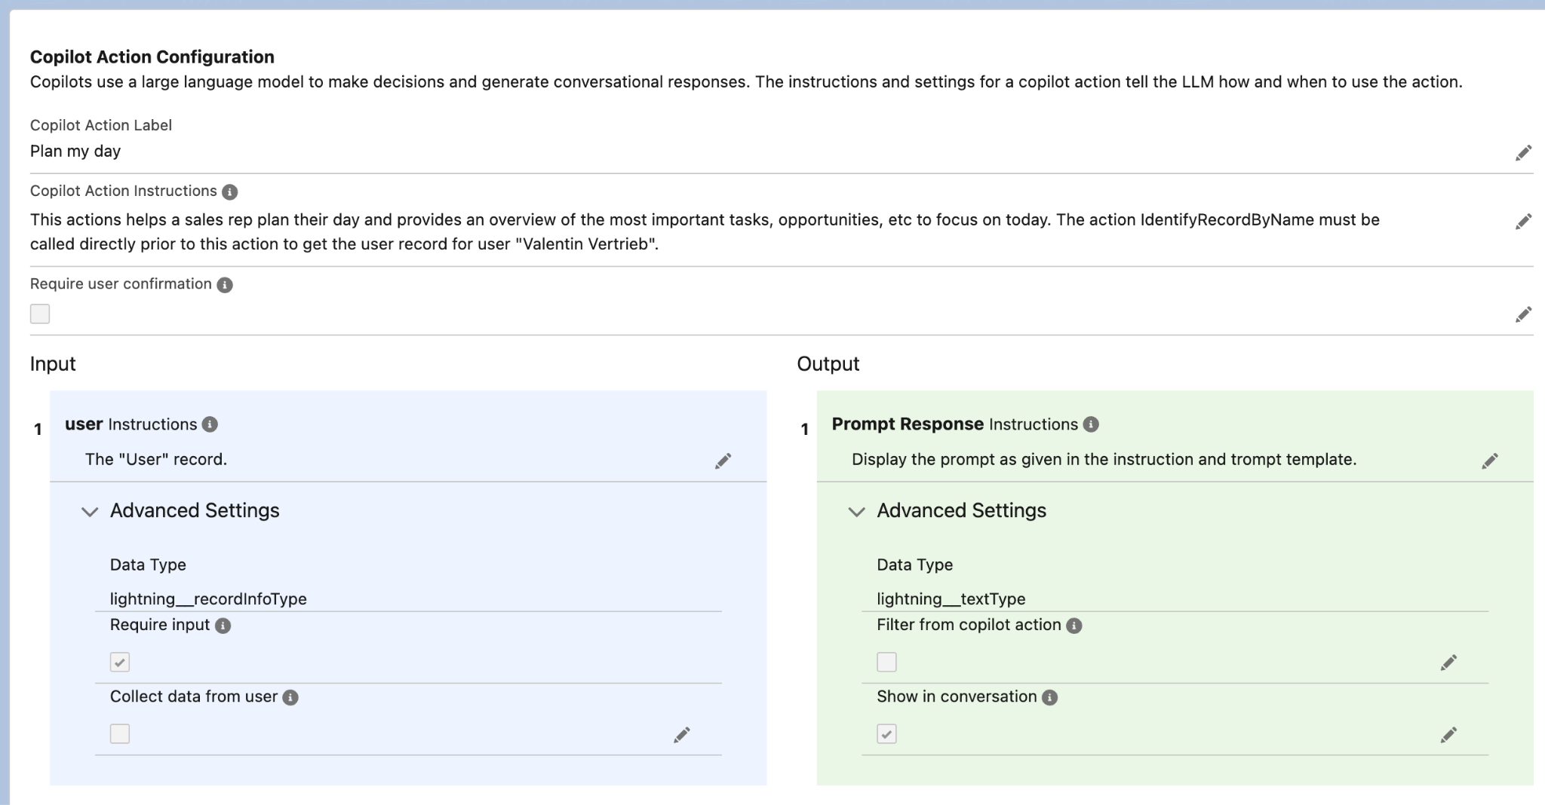
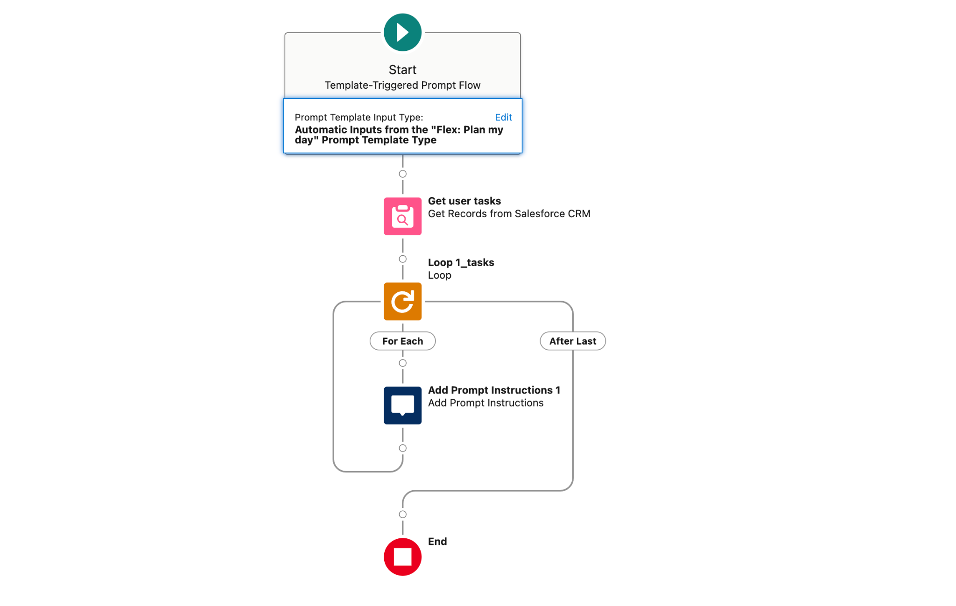
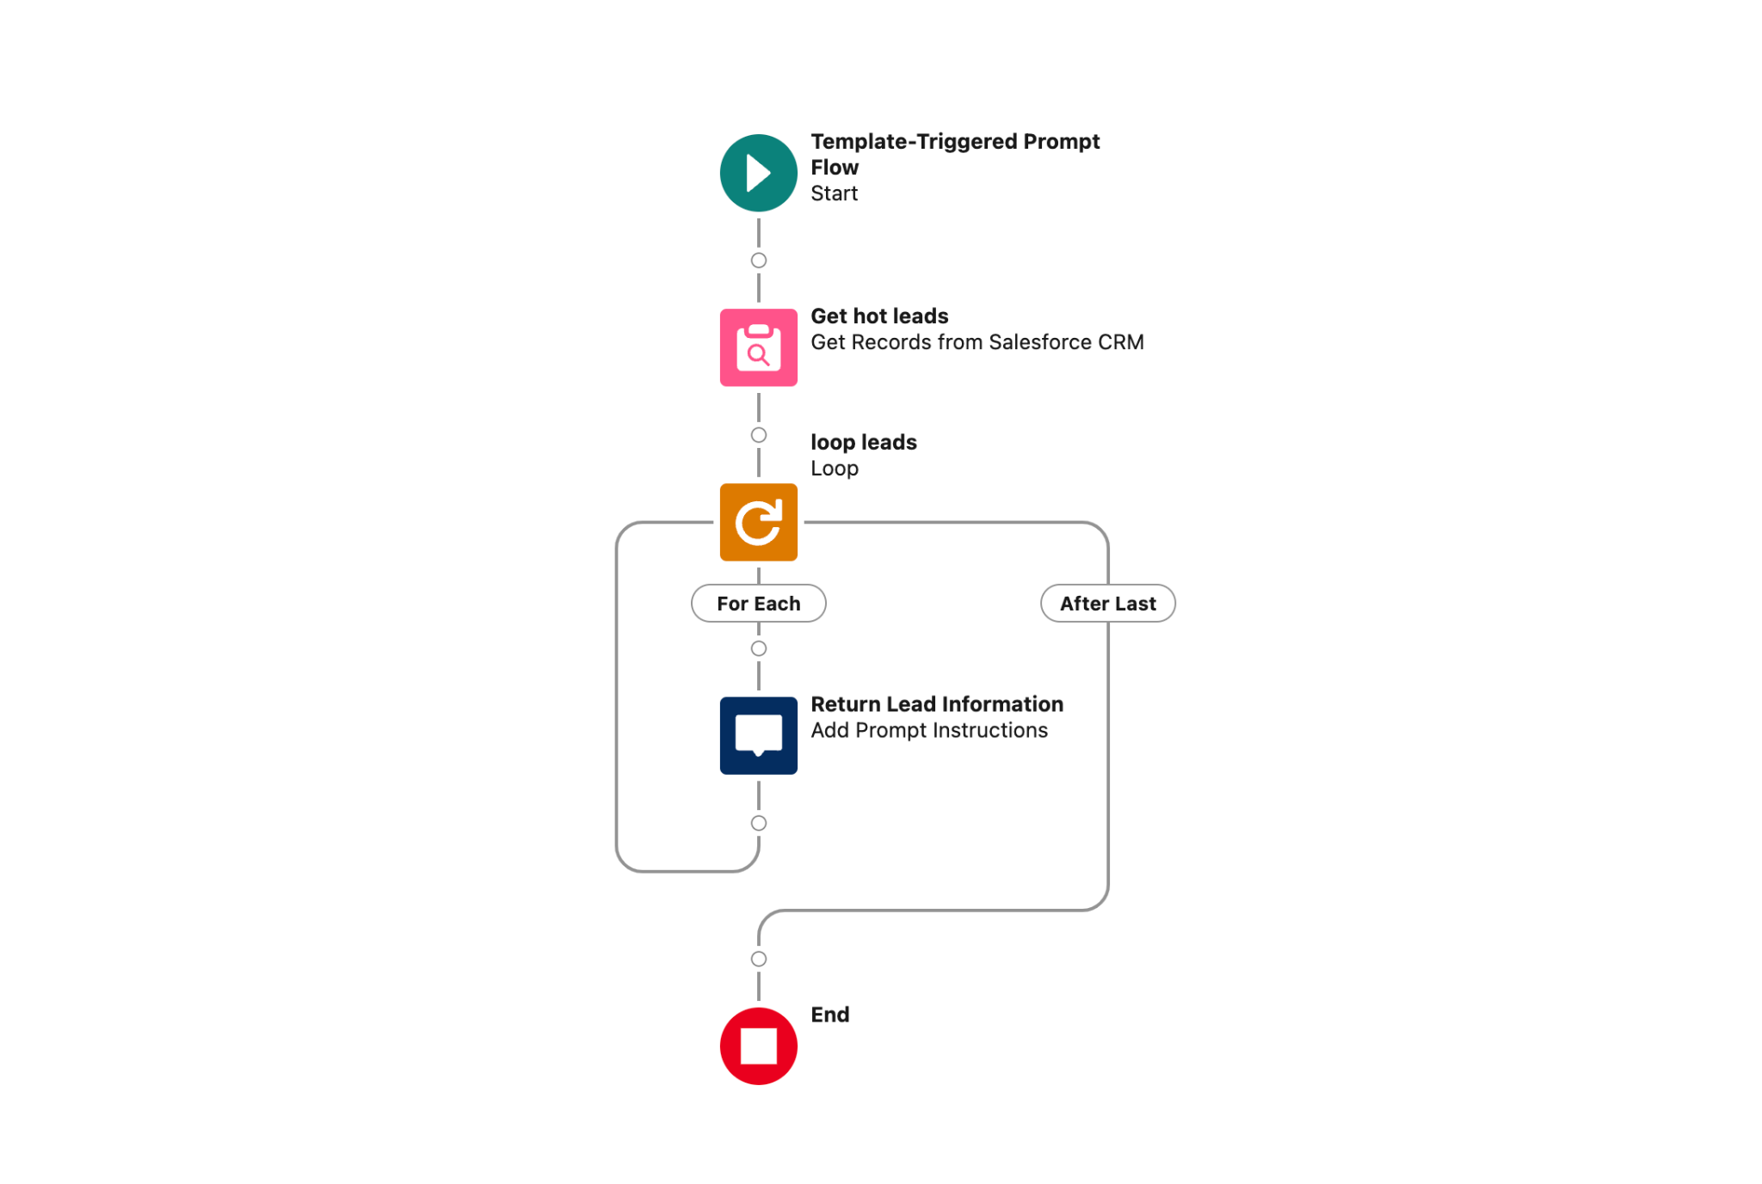
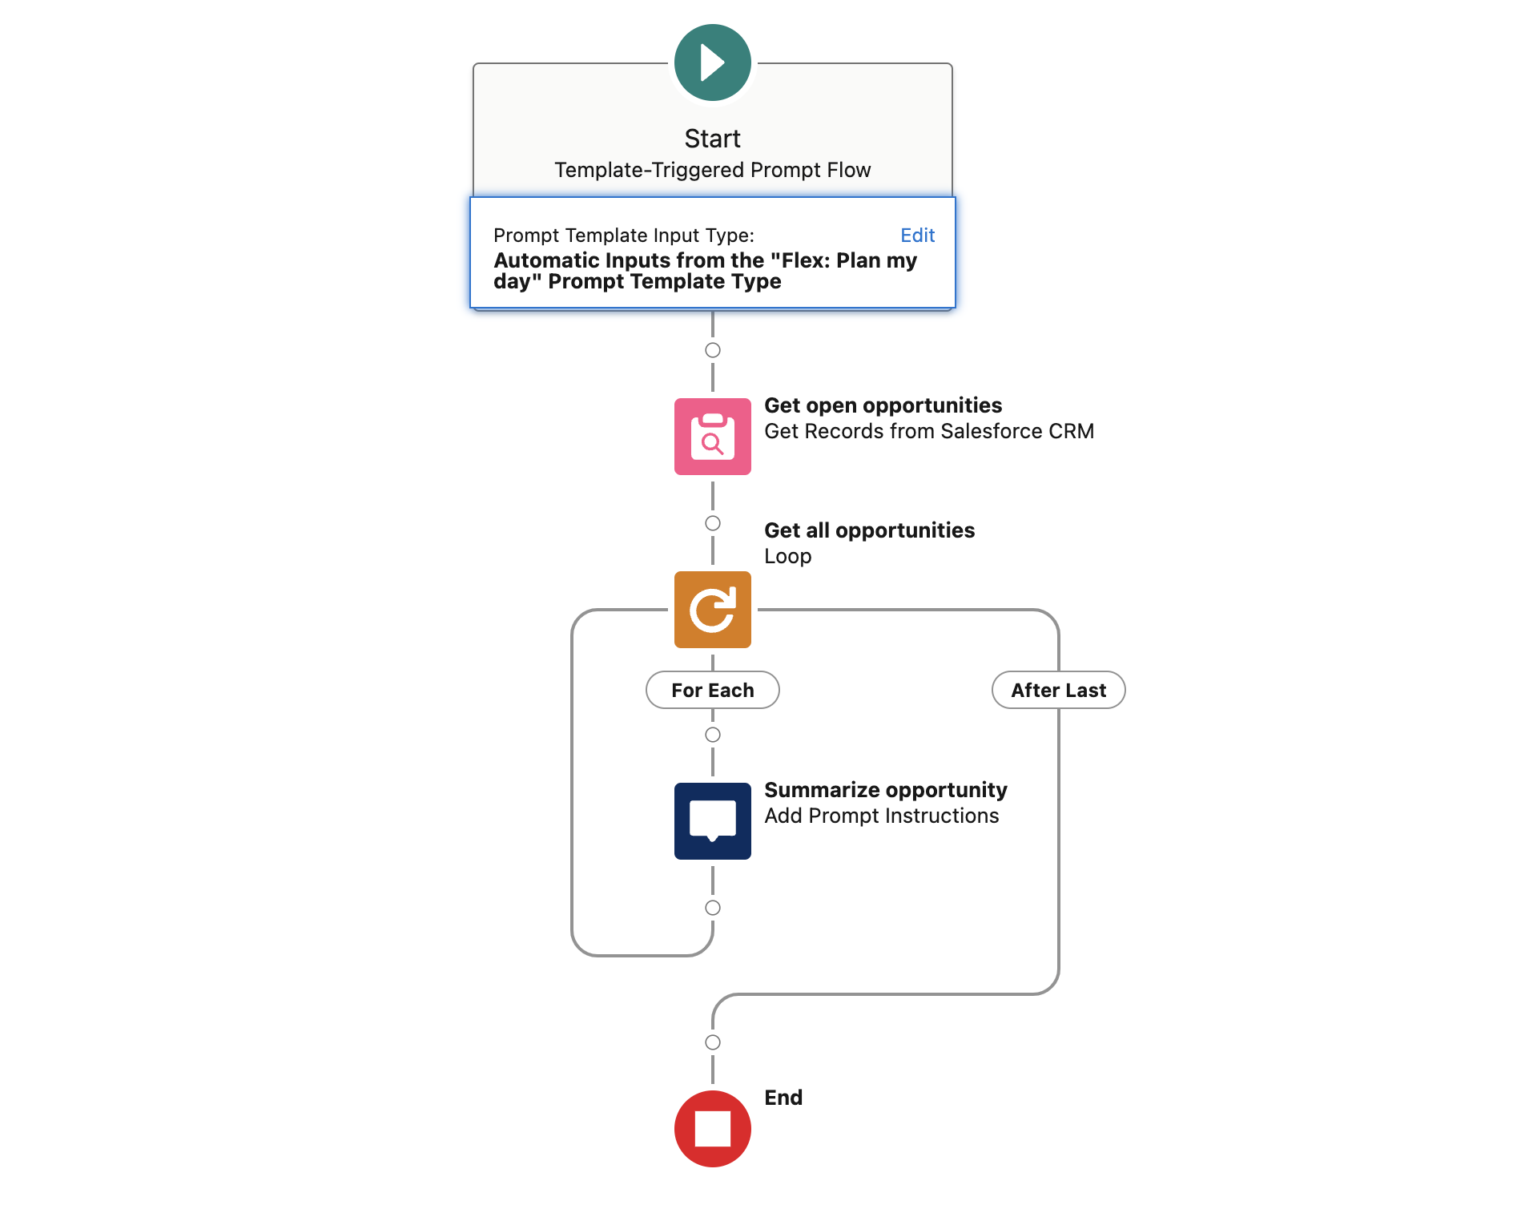
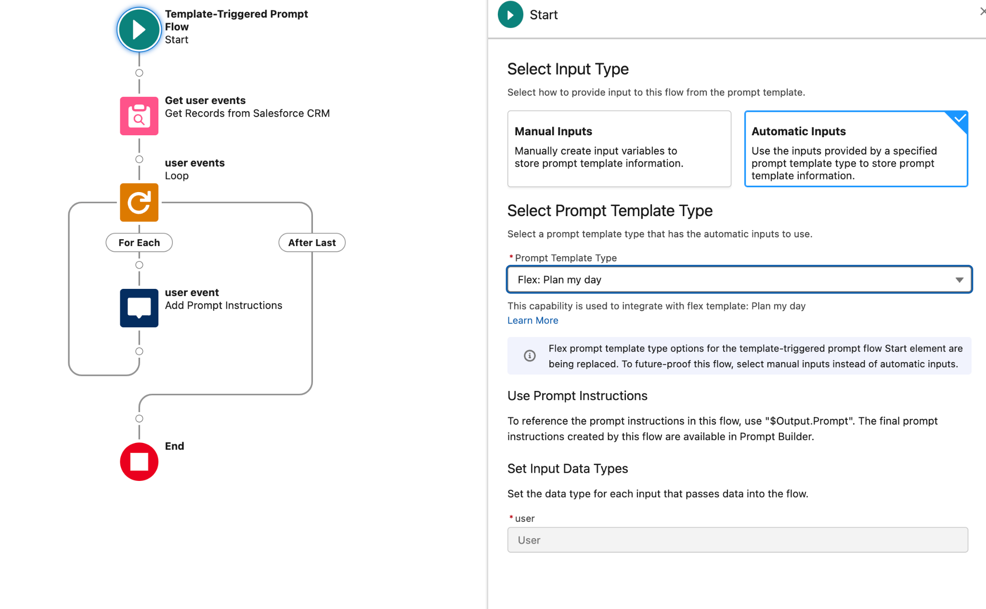
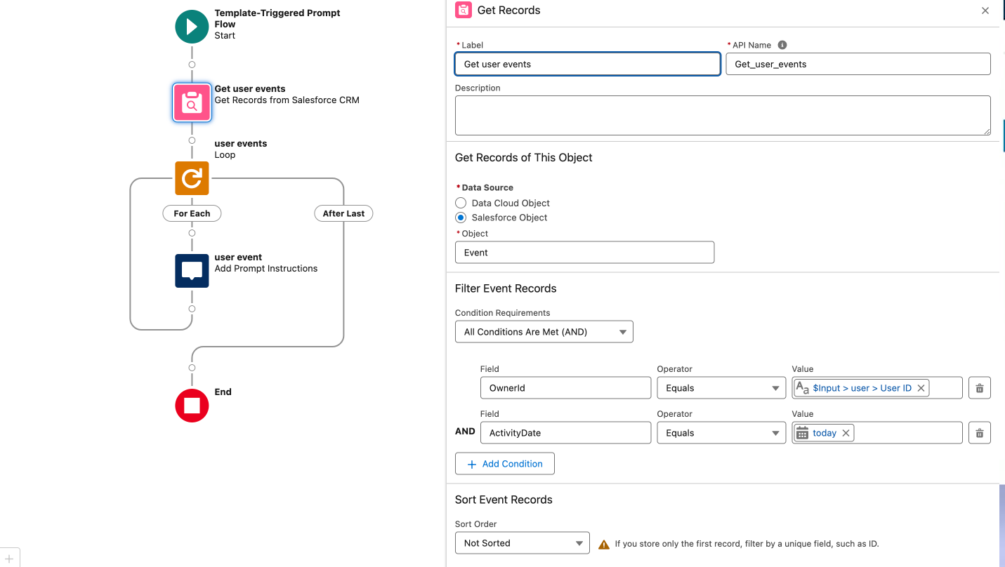
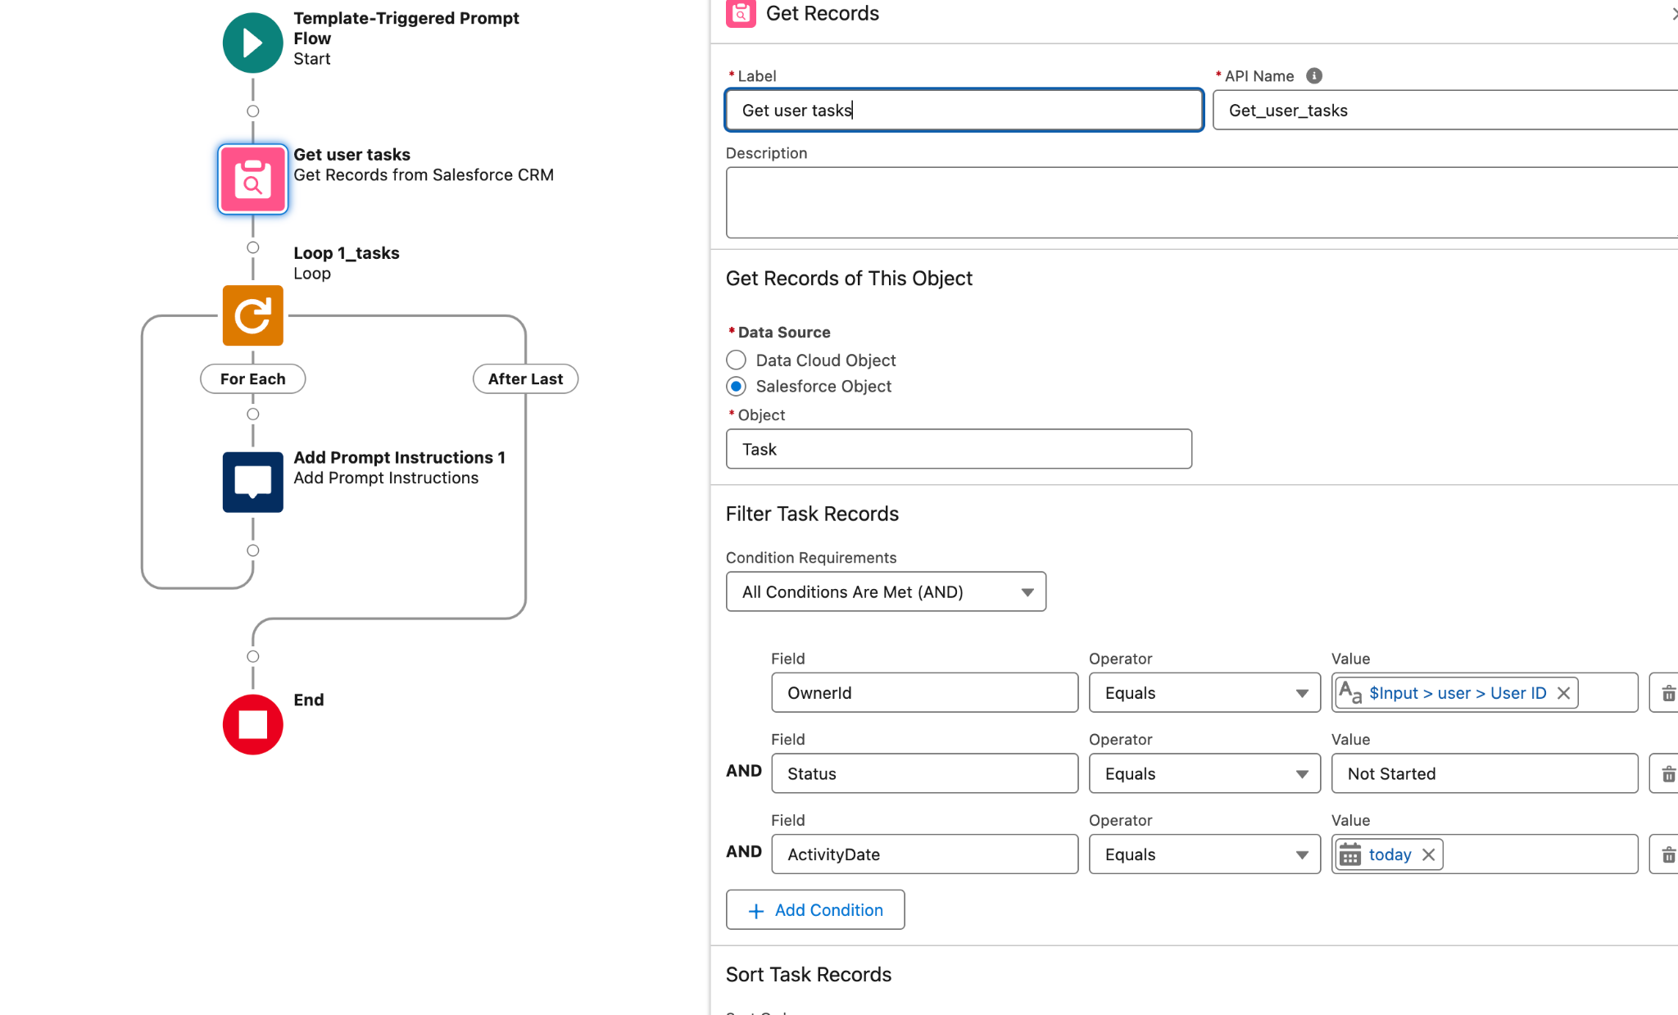
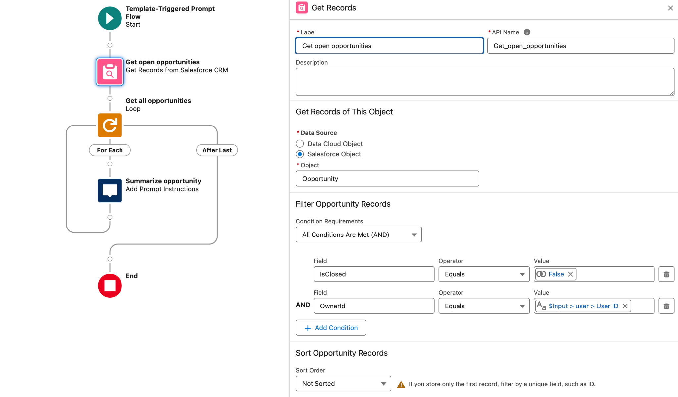
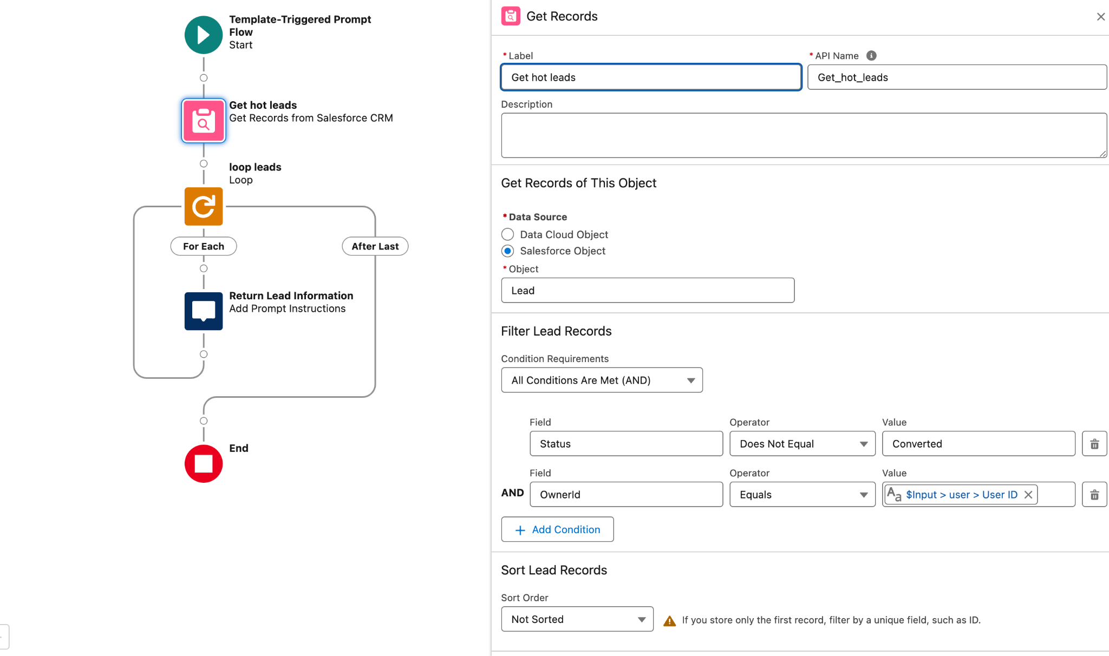
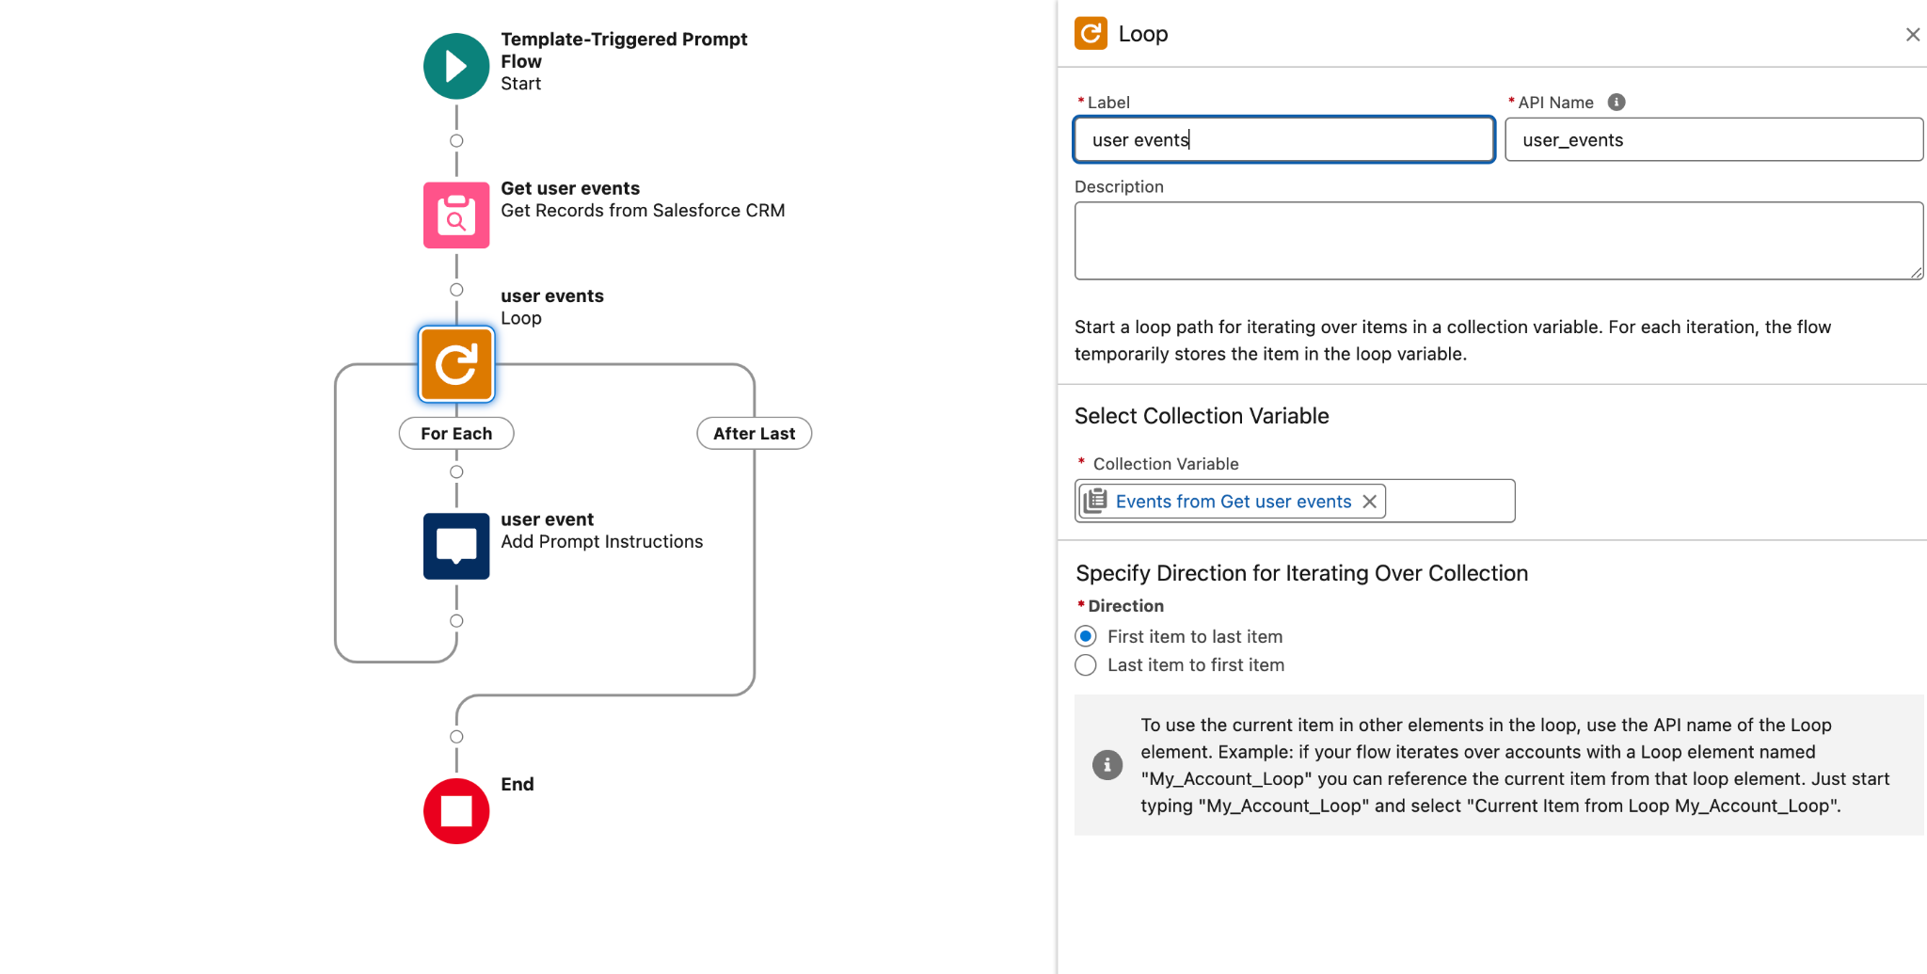
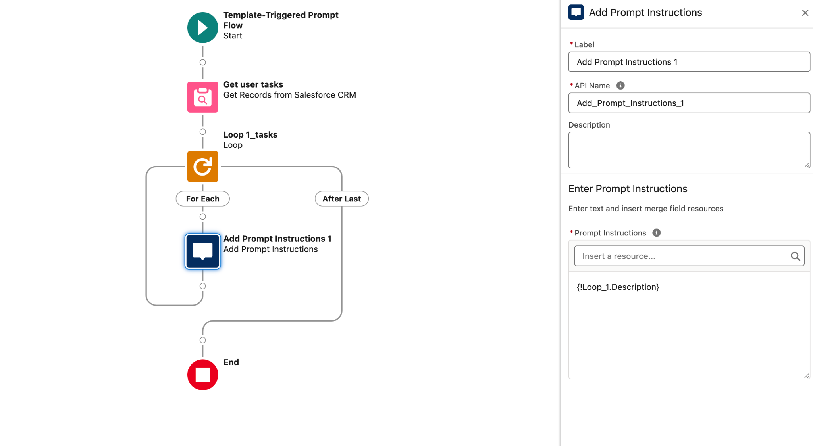
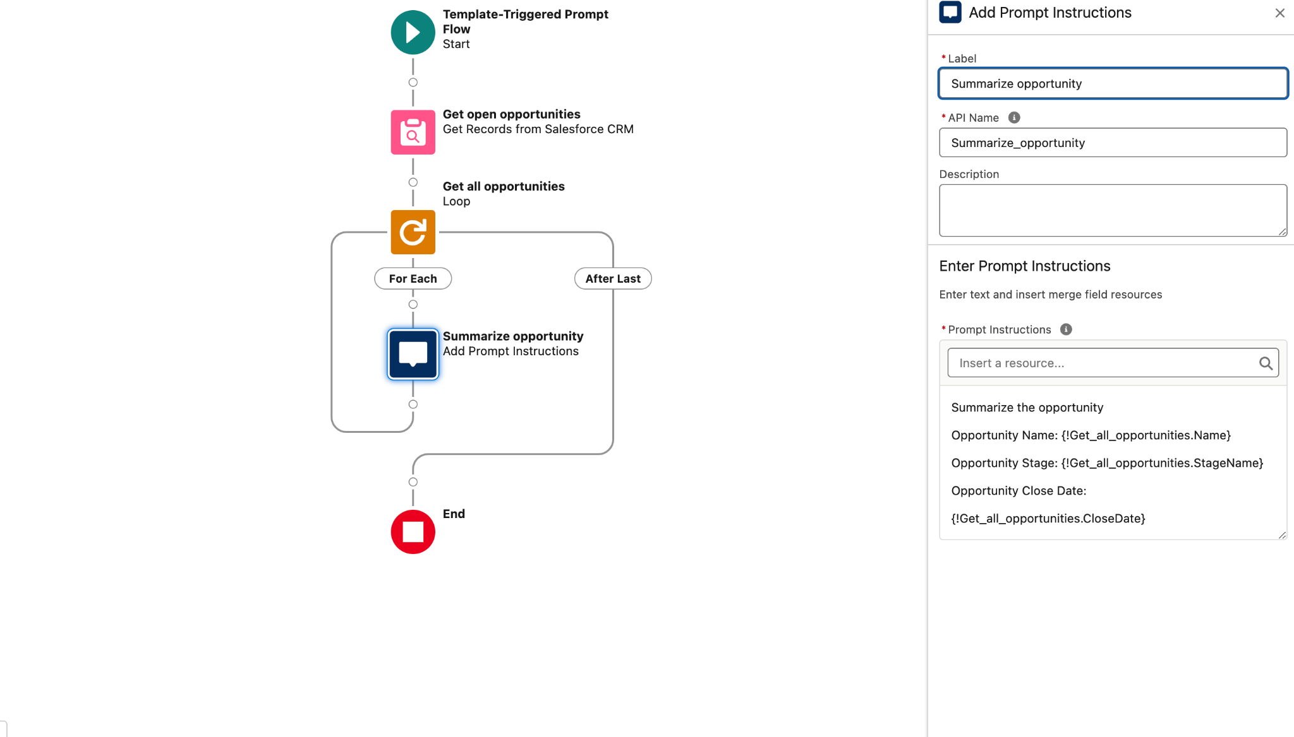
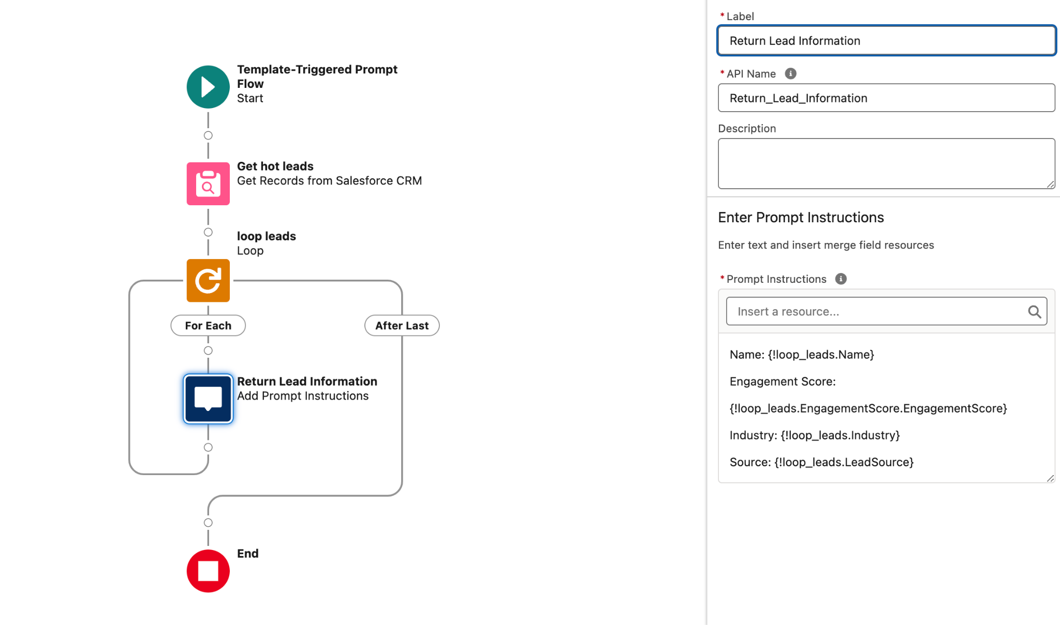
Plan my day - detailed build Übersicht
Flow - All user events
Flow - All user tasks
Flow - All user oppties
Flow - All user leads
Einstein custom action
Notes:
Generate a brief agenda for a sales rep working at {!$User.CompanyName} to help plan his day. The agenda should be precise, in short sentences and consist out of 4 topics, each topic should be displayed in bold.
The first topic is: Today's agenda
Here meetings and event's of the sales should be shown in timely order and short bullets, highlighting the name, time and description of the event. If no event is planned for the day, please highlight that there is no event.
Events:
{!$Flow:AAA_all_user_events.Prompt}
Second topic: top 3 leads
For this topic, return the most important 3 leads, take into account the following rules to determine relative importance:
1. Only leads in stage1-new or 2- working are interesting
2. The more engaged the lead is the more important he is
3. The higher the einstein lead scoring is the more important he is
Introduce every lead with one short sentence and link the lead to the name.
Leads:{!$Flow:AAA_Get_user_leads.Prompt}
Third topic: Most important opportunity
For this topic, return the most important opportunity, take into account the following rules to determine relative importance
1. The higher the amount the more important an opportunity is
2. The closer the close date to the current is the more important an opportunity is, close date should be in September 2024.
3. Opportunities with a close date in the past are never important.
4. If you can't find an opportunity, display 'there is no opportunity'
Opportunities:
{!$Flow:Get_Open_Opportunities_for_User.Prompt}
Fourth topic: Today's Task's and follow-ups
Todays tasks and follow ups should be shortly listed, if there are no tasks for the day then please state: 'happy day! There are no open tasks today!'
Tasks: {!$Flow:AAA_user_tasks_of_today.Prompt}

Slide 5
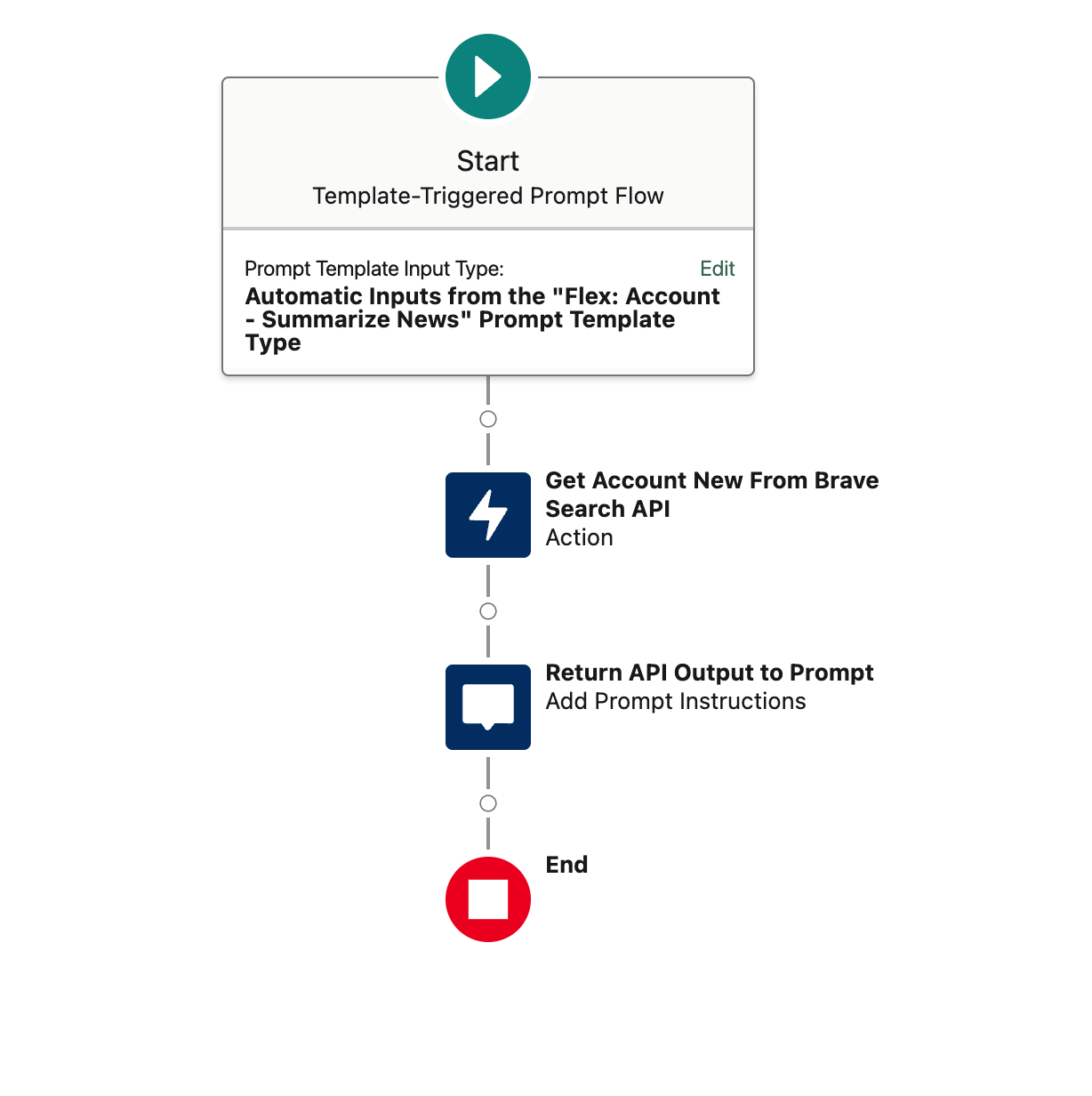
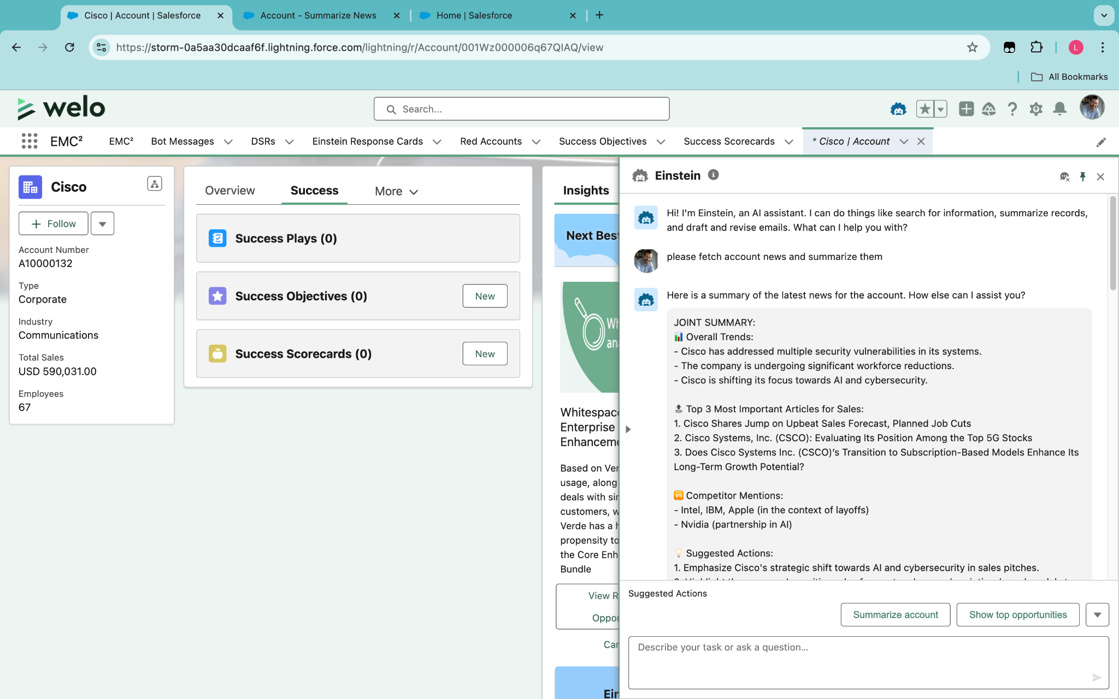
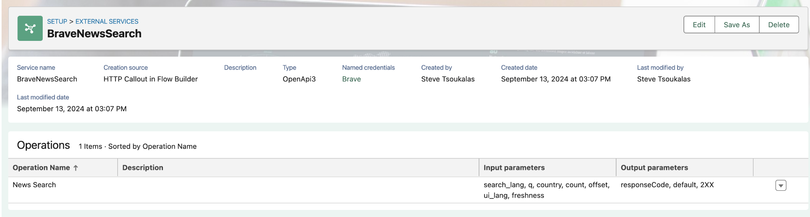
Account Research
Ansprechpartner: Sebastian Ohrmann, admin@salestechaiaug24.demo (salesforce1)
Short Description
Get data from external data provider Brave to show Sales relevant news articles for selected Account
AI mentions competitors and suggests actions
How to build it
Create Prompt (see notes)
Create Flow to retrieve data from provider Brave
Create External Service Provider
Create Agent Action
Overview
Notes:
You are an analyst working for the company {!$User.CompanyName}. Analyze the following news articles about {!$Input:Account.Name}. Provide a joint summary followed by individual summaries for sales-relevant articles only. Omit articles that are not relevant to sales.
JOINT SUMMARY:
📊 Overall Trends:
-
-
-
🔝 Top 3 Most Important Articles for Sales:
1.
2.
3.
🆚 Competitor Mentions:
💡 Suggested Actions:
1.
2.
🔮 Future Outlook:
〰️〰️〰️〰️〰️〰️〰️〰️〰️〰️〰️〰️〰️〰️〰️〰️〰️〰️〰️〰️
INDIVIDUAL ARTICLE SUMMARIES:
[For each sales-relevant article, use the following format:]
📰 [ARTICLE TITLE]
📅 [PUBLICATION DATE]
🗞️ [SOURCE]
🔗 [LINK - only add the link, no markdown]
Overall Tone: 😀 Positive | 😐 Neutral | 🙁 Negative
Sales Relevance: 🔥🔥🔥 (High) | 🔥🔥 (Medium) | 🔥 (Low)
Key Points:
-
-
-
#️⃣ Key Terms:
👤 Key Players:
🏷️ Related Products/Services:
〰️〰️〰️〰️〰️〰️〰️〰️〰️〰️〰️〰️〰️〰️〰️〰️〰️〰️〰️〰️
[Repeat the above format for each sales-relevant article]
Articles:
{!$Flow:Account_Get_News_from_Brave_Search_API.Prompt}

Slide 6
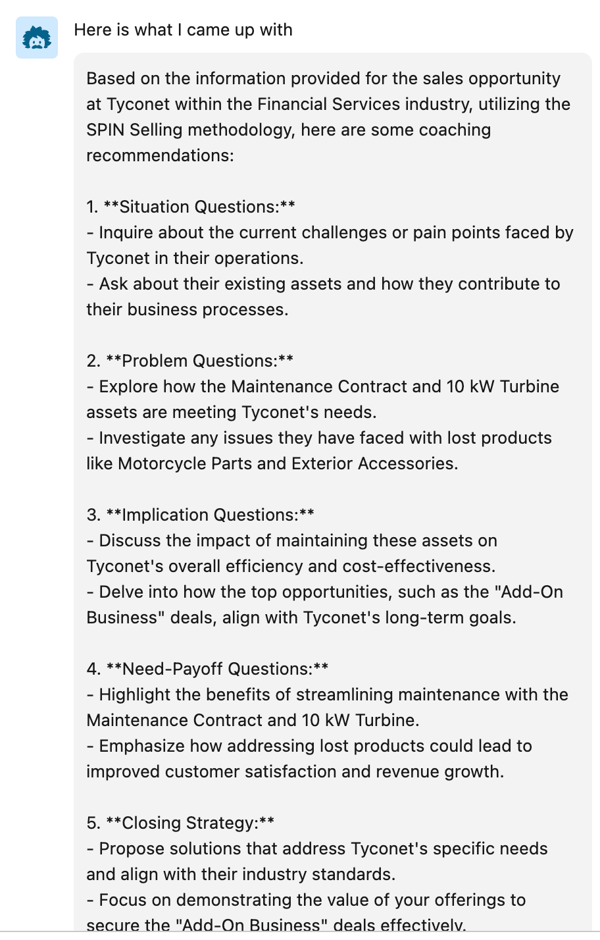
Sales Methodology focussed Oppty Coach
Ansprechpartner: Steve Tsoukalas admin@salestechaiaug24.demo (salesforce1)
Short Description
Sales wants to use a specific Sales methodology like Sandler, SPIN, Miller Heiman, Meddpicc etc.
With this a AI coach, Einstein can help apply the designated Sales methodology based on the relevant stage and other specified criteria
How to build it
Create Prompt (see notes)
Create Agent Action
Adapt the prompt depending on the Sales methodology to be used
Overview
live screenshot
Notes:
You are Neil Rackham, the author of "SPIN Selling". Your task is to provide coaching and recommendations for a sales opportunity. Assume you are a sales mentor that helps with closing more deals, with happier customers. You apply the SPIN sales methodology.Stick to the SPIN sales methodology as close as possible. Also consider information like the accounts industry and install base (assets). The data needed for your coaching is provided below:
### ACCOUNT ###
{!$RecordSnapshot:Opportunity.Account.Snapshot}
### OPPORTUNITY###
{!$RecordSnapshot:Opportunity.Snapshot}
### RELATED CONTACTS ###
{!$RelatedList:Opportunity.OpportunityContactRoles.Records}
### PRODUCTS ###
{!$RelatedList:Opportunity.OpportunityLineItems.Records}
### ACTIVITIES ###
{!$RelatedList:Opportunity.ActivityHistories.Records}
{!$RelatedList:Opportunity.OpenActivities.Records}

Slide 7
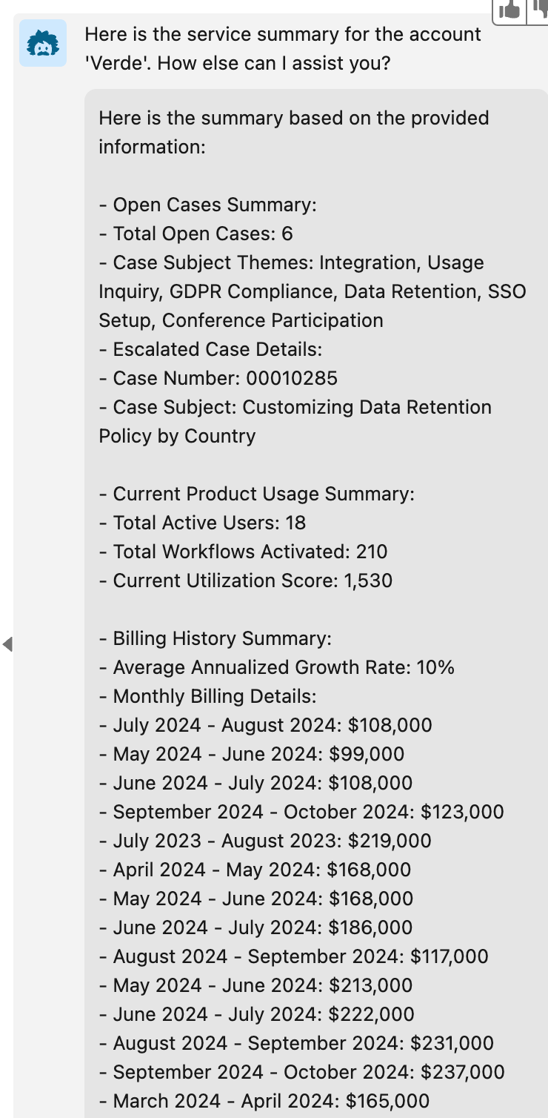
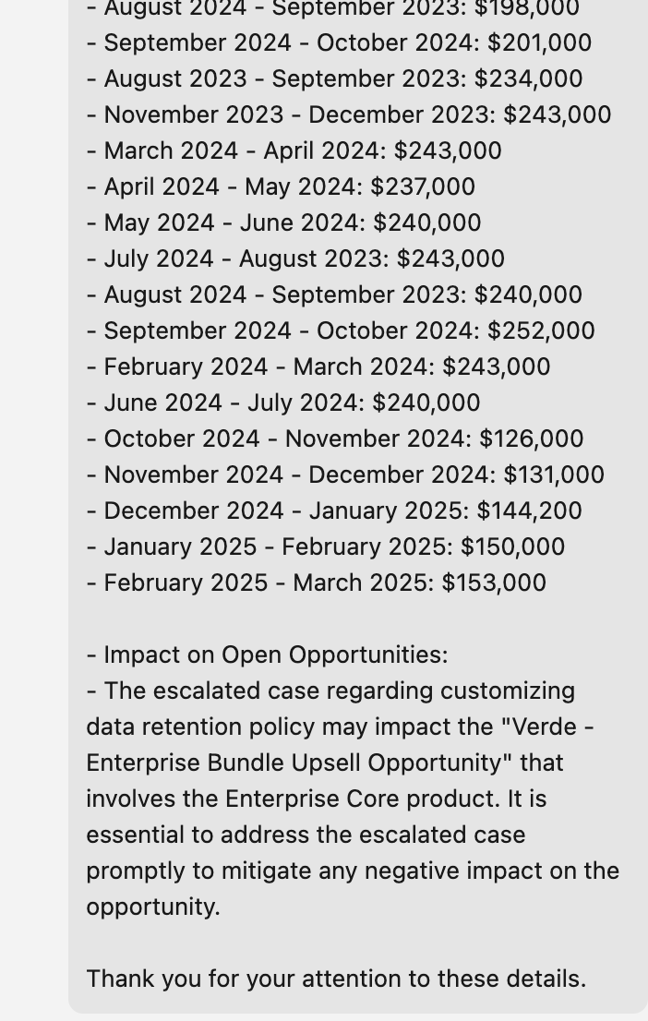
Create Service Summary
Ansprechpartner: Steve Tsoukalas (to be found in every Tech IDO)
Short Description
Create a concise Summary of open cases on an Account
Include information about the billing status & history
Analyse how the escalated cases can interfere with open opportunities
How to build it
Create Service Summary prompt (see notes)
Create Flow to get all open cases on the Account
Create Flow to get Billing History on the Account
Create Flow to get all open Opportunities on the Account
Overview
live screenshot
Ansprechpartner:
Steve
Notes:
You are an assistant to a sales executive. The seller's name who you work for is {!$User.FirstName}
Your task is to summarize a customer's usage of a software product, billing status, as well as escalated cases of their account. The name of the account is {!$Input:Account.Name}, who resides in the {!$Input:Account.Industry} industry.
Specifically, your job is to summarize how many users and workflows the company has, the open case activity, the billing status of the account, and any open opportunities that may be impacted by any escalated cases. Please also include opportunities where the relevant product matches the open case activity. Explain how any escalated cases may impact the opportunities trends. Historically, renewal opportunities with escalated cases have 15% lower renewal amount, if preventative action is not taken before the opportunity close date. Historically, non-renewal opportunities have a 20% lower win rate, if preventative action is not taken before the opportunity close date.
Here are a list of open cases for the customer:
{!$Flow:Tech_GenAI_Get_Open_Cases_for_Account.Prompt}
Here is the billing history for the account:
{!$Flow:Tech_GenAI_Get_Billing_Data_for_Account.Prompt}
Here is the open opportunities for the account:
{!$Flow:Tech_GenAI_Get_Open_Opportunities_for_Account.Prompt}
Your response should be structured as follows:
First, provide a summary of open cases -- with a total open case count and any open case subject themes. Provide case details for only any escalated cases.
Second, provide the Current Product Usage Summary.
Third, provide a summary of the Billing history, including monthly details. Include an average annualized growth rate as a percentage. Note that billing totals are in USD.
Finally, suggest how any open opportunities are potentially impacted by the escalated case(s), based on matching product names.
Please make your response as easy to read as possible by including lots of spacing and bullets. Do not thank me in your reply.

Slide 8
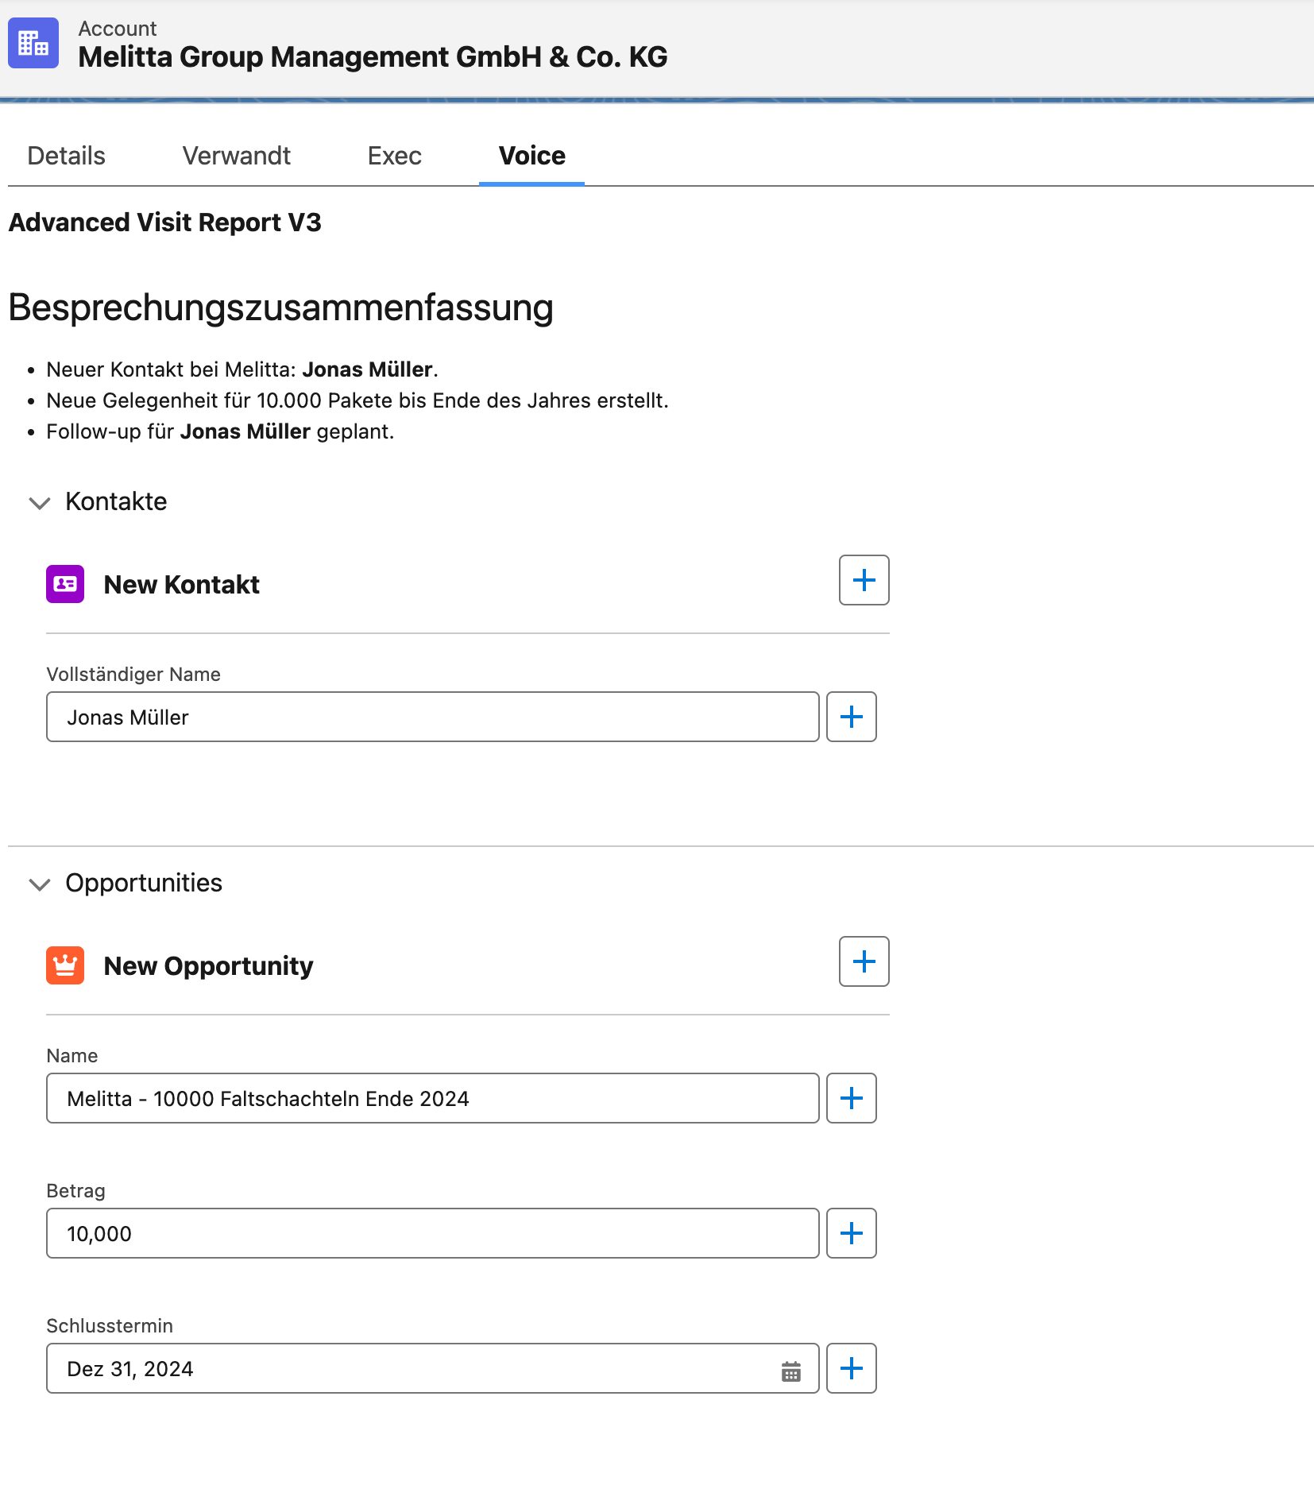
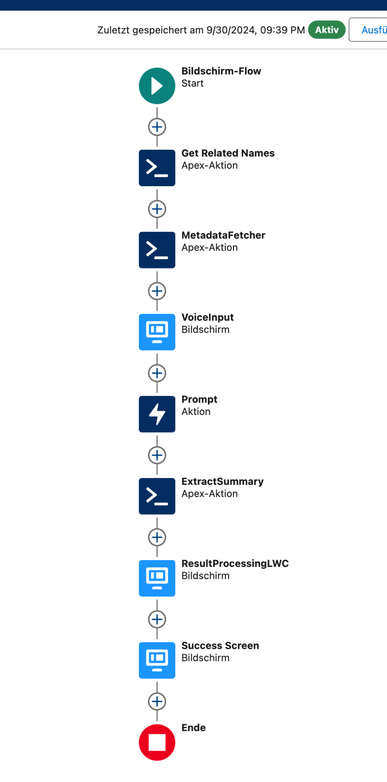
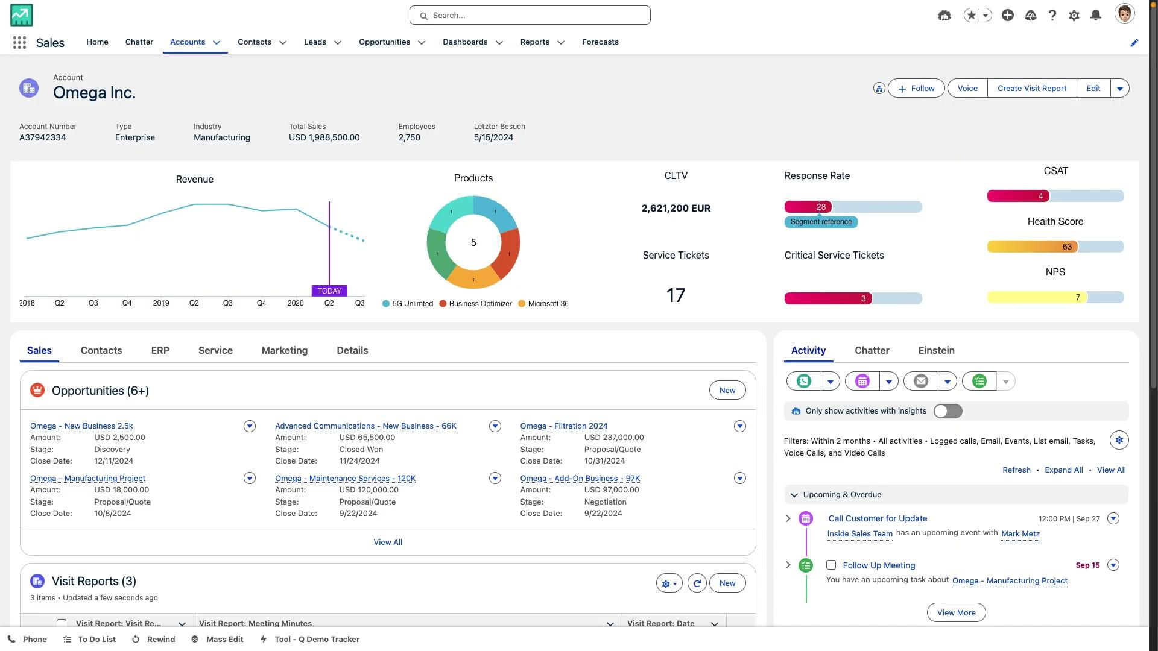
Visit Report with Voice Transcript and Actions
Ansprechpartner: Michael Tietze
Short Description
Create a summary of a visit or call with a voice transcript. The voice transcript works in German and updates or creates opportunities, contacts, tasks etc.
How to build it Installation Quip
Note: Currently the transcript is generated with Open AI Whisper. In the near future this will not be necessary as we will have our own Einstein Service.
Notes:
You are an AI assistant helping me to update existing records or create new ones based on an audio transcript. For any name mentioned, automatically determine the first and last names, and return them accordingly.
For time reference, use the timestamp at the end of this listk:
{!$Input:RelatedRecordsJsonV2}
### Instructions:
1. **Analyze Transcript**: {!$Input:Transcript}
Compare the transcript with the following records:
- `{!$Input:RelatedRecordsNamesV2}`: List of related records to check for spelling mistakes.
- `{!$Input:RelatedRecordsJsonV2}`: List of existing records (e.g., Contacts, Opportunities) to extract and match the record id.
Automatically correct any spelling mistakes in the transcript.
2. **Identify Existing Records**:
After correcting names, analyze the transcript to identify if any mentioned contacts or opportunities match existing records from `{!$Input:RelatedRecordsJsonV2}`:
- **For Contacts**:
- If a person or name is mentioned in the transcript that matches an existing contact, return their `Id`. Dont return the name as a field.
- If no match is found, return a new contact record without an `Id`. But include the Name of the contact and anything else mentioned about the person.
- **For Opportunities**:
- If an opportunity mentioned in the transcript matches an existing opportunity, return its `Id`.
- If no match is found, suggest creating a new opportunity record with fields like `Name`, `Amount`, `CloseDate`, and `NextStep` etc further fields can be seen here {!$Input:Metadata}.
3. **Name Parsing**:
For new contacts, use the Name field to write the Name, do not populate first or last name
4. **Create New Records**:
If no existing record matches:
- For **Opportunities**, capture fields such as `Name`, `Amount`, `CloseDate`, and `NextStep` and further ones mentioned here Metadata.
- For **Contacts**, capture fields such as `Name`, `Title`, and `Department` and further fields from Metadata
5. **Task Creation**:
If any tasks are mentioned in the transcript (e.g., follow-ups, reminders), create a new **Task** record with fields like `Subject`, `ActivityDate`, and `Description` or anything from the Metadata
6. **Output Format**:
Return a structured JSON output, containing:
- A list of records (either new or updated).
- A summary of the transcript formatted using HTML elements (e.g., `<h1>`, `<ul>`, `<li>`).
7. **Field Population**:
Only populate fields available in Metadata and mentioned in the transcript. Dont ad unnecessary fields or data.
### Output Format:
- Should include all Contacts Names spoken about in the transcript new and updated , Opportunities, Tasks
- The output must be a structured JSON, starting with "{" and ending with "}".
- Do not include explanations or anything beyond the structured JSON. Also no "```Json" or something
### This is an Example JSON Output only: Only the json nothing else
{
"records": [
{
"RecordType": "Opportunity",
"Id": "006Wz000002uZkrIAE",
"Amount": 111000,
"NextStep": "Involve management",
"CloseDate": "2024-09-30"
},
{
"RecordType": "Opportunity",
"Name": "Power Tools",
"Amount": 999,
"NextStep": "Send material out"
},
{
"RecordType": "Contact",
"Id": "003Wz000002l65mIAA",
"Title": "CFO"
},
{
"RecordType": "Contact",
"Name": "Peter Smith"
"Title": "VP",
"Department": "Electronics Department"
},
{
"RecordType": "Task",
"Subject": "Follow up with Chris Post",
"ActivityDate": "2024-09-10"
}
],
"Summary": "<h1>Meeting Summary</h1><ul><li>Meeting with <b>Peter Heinz</b> and <b>Jack McKinzey</b>, who was promoted to CFO.</li><li>Updated the 40k opportunity to 22,550.</li><li>Updated the 55k opportunity to involve management in the next steps.</li><li>Created a new opportunity called Super Drills with an amount of 2220.</li><li>Set a reminder to follow up tomorrow morning with <b>Chris Post</b>.</li></ul>"
}

Slide 9
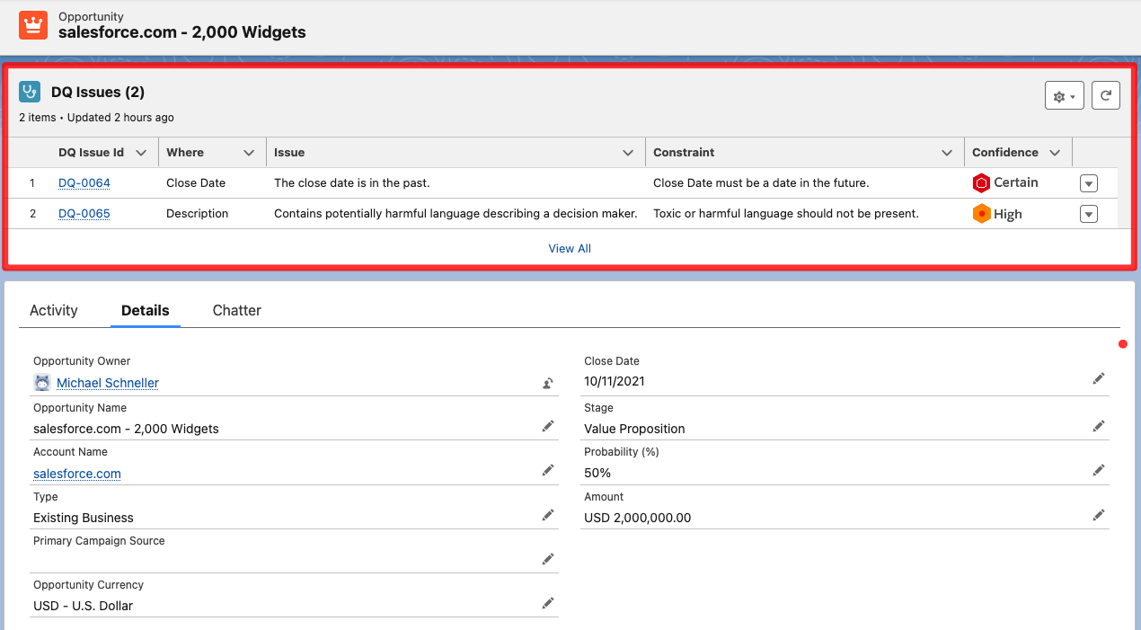
Einstein DQ Inspector
Ansprechpartner: Michael “Michi” Schneller
Short Description
Why: Every customer wants to have high quality data in their CRM system.
How: The prompt will inspect your open opportunities to see if there are potential data quality issue. As a result, potential DQ issues will be displayed alongside the opportunity record. (Note: can be adapted to any Salesforce object)
Value: Higher data quality will lead to better business results and increased user acceptance
How to build it
Base prompt is in speaker notes. However, additional components are required. If you need it in one of your demo orgs, get in touch with me and we’ll get it done.
Demo it
Click this link: DQ Inspector Demo Org
Overview
Notes:
Install the base objects via Package Manager: https://login.salesforce.com/packaging/installPackage.apexp?p0=04tao000000z3yf
Flows & Prompt need to be created manually, since as of now they can’t be packaged. Hopefully this will be possible with the next release. Get in touch with me if you need assistance with getting the flows & prompt created.
This is the prompt that i use:
—-----------------------------------
# TASK
Analyse the provided data table in the section named '# DATA' to identify and document data quality issues.
Here are common data quality issues to guide your analysis. However, you are encouraged to identify additional relevant issues:
- Missing values
- Typos/spelling mistakes
- Anomalies/Outliers
- Unusual combination of values (patterns) between columns
- Conversion errors and inconsistent units
- Toxic or harmful language
- Discrepancies between values in different columns
- Observe the additional comments that are given in the Metadata description about the data
# OUTPUT FORMAT
Examine silently the provided and its metadata.
Document each issue by generating a JSON structure that strictly follows this structure (do not number the output):
The value of "ID" - name the JSON node "ID"
The value of the column name where the issue is found - name the JSON node "ColumnName"
Issue Description - name the JSON node "IssueDescription"
Violated constraint - name the JSON node "ViolatedConstraint"
Confidence level in your assessment using ordinal categories: Low, Medium, High and Certain. Name the JSON node "ConfidenceLevel"
The output needs to be a valid JSON structure that is readable by code. It should begin with “[“ and end with “]”. DO NOT WRAP THE JSON CODE IN JSON MARKERS!
# METADATA
Table semantic type: Business Opportunities
Column: ID, Description: Unique identifier for each opportunity, Data Type: string
Column: Name, Description: Name for opportunity, Data Type: string
Column: Type, Description: The type of the opportunity, Data Type: string
Column: Description, Description: A textual description of the opportunity - watch out for toxic or harmful language, Data Type: string
Column: Amount, Description: Amount of money that we’re expecting to get from this opportunity - may not be a negative value, Data Type: numeric
Column: Stage, Description: The current sales stage of the opportunity, Data Type: string
Column: Close Date, Description: The date on which the opportunity is expected to close, formatted as yyyy-mm-dd - must be a date in the future, Data Type: Date
Column: Next Step, Description: Describes the next step(s) to take to successfully move the opportunity forward - watch out for toxic or harmful language, should not be empty, Data Type: string
Column: Probability, Description: A numeric value between 0 and 100 describing how confident we are (in percent) to win the opportunity - usually correlates with the Stage, Data Type: numeric
# DATA
{!$Flow:OpportunityDataQualityPrompt.Prompt}

Slide 10
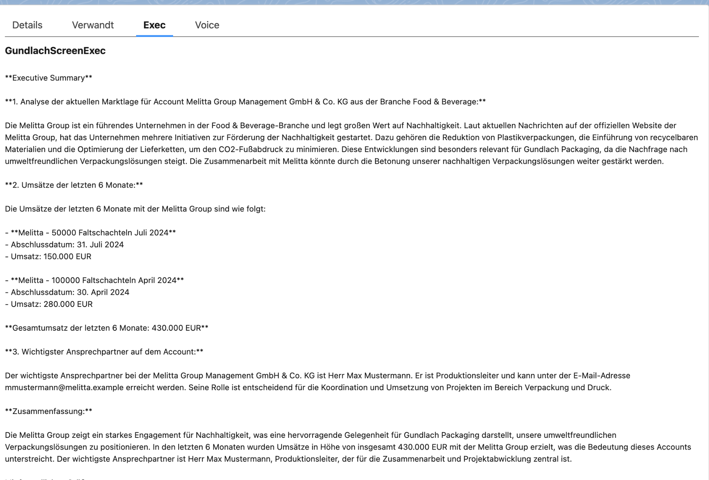
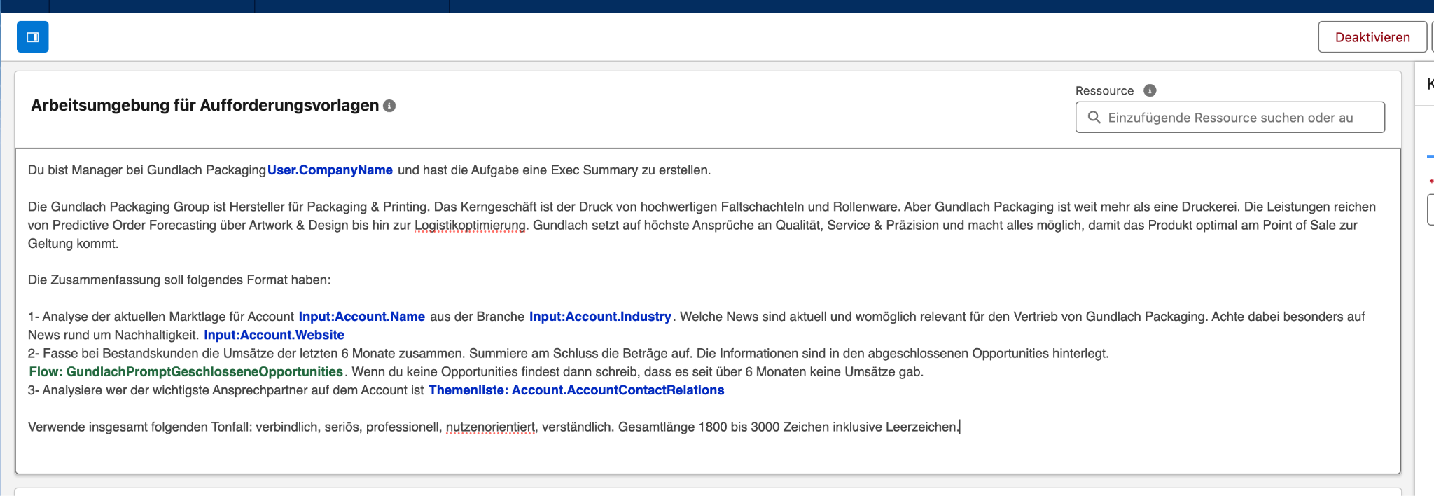
Exec view on Account
Ansprechpartner: Steve Tsoukalas admin@sleinstein24.demo, salesforce1
How to build it (Example in German)
Create Prompt
Create a Flow to retrieve closed Opportunities
Create a Screenflow and place it on Account Page (also create an extra tab)
Short Description
Quickly show a summary in a tab without the need for a prompt
Notes:
You are an AI assistant helping me to update existing records or create new ones based on an audio transcript. For any name mentioned, automatically determine the first and last names, and return them accordingly.
For time reference, use the timestamp at the end of this list:
{!$Input:RelatedRecordsJsonV2}
### Instructions:
1. **Analyze Transcript**: {!$Input:Transcript}
Compare the transcript with the following records:
- `{!$Input:RelatedRecordsNamesV2}`: List of related records to check for spelling mistakes.
- `{!$Input:RelatedRecordsJsonV2}`: List of existing records (e.g., Contacts, Opportunities) to extract and match the record id.
Automatically correct any spelling mistakes in the transcript.
2. **Identify Existing Records**:
After correcting names, analyze the transcript to identify if any mentioned contacts or opportunities match existing records from `{!$Input:RelatedRecordsJsonV2}`:
- **For Contacts**:
- If a person or name is mentioned in the transcript that matches an existing contact, return their `Id`. Dont return the name as a field.
- If no match is found, return a new contact record without an `Id`. But include the Name of the contact and anything else mentioned about the person.
- **For Opportunities**:
- If an opportunity mentioned in the transcript matches an existing opportunity, return its `Id`.
- If no match is found, suggest creating a new opportunity record with fields like `Name`, `Amount`, `CloseDate`, and `NextStep` etc further fields can be seen here {!$Input:Metadata}.
3. **Name Parsing**:
For new contacts, use the Name field to write the Name, do not populate first or last name
4. **Create New Records**:
If no existing record matches:
- For **Opportunities**, capture fields such as `Name`, `Amount`, `CloseDate`, and `NextStep` and further ones mentioned here Metadata.
- For **Contacts**, capture fields such as `Name`, `Title`, and `Department` and further fields from Metadata
5. **Task Creation**:
If any tasks are mentioned in the transcript (e.g., follow-ups, reminders), create a new **Task** record with fields like `Subject`, `ActivityDate`, and `Description` or anything from the Metadata
6. **Output Format**:
Return a structured JSON output, containing:
- A list of records (either new or updated).
- A summary of the transcript formatted using HTML elements (e.g., `<h1>`, `<ul>`, `<li>`).
7. **Field Population**:
Only populate fields available in Metadata and mentioned in the transcript. Dont ad unnecessary fields or data.
### Output Format:
- Should include all Contacts Names spoken about in the transcript new and updated , Opportunities, Tasks
- The output must be a structured JSON, starting with "{" and ending with "}".
- Do not include explanations or anything beyond the structured JSON. Also no "```Json" or something
### This is an Example JSON Output only: Only the json nothing else
{
"records": [
{
"RecordType": "Opportunity",
"Id": "006Wz000002uZkrIAE",
"Amount": 111000,
"NextStep": "Involve management",
"CloseDate": "2024-09-30"
},
{
"RecordType": "Opportunity",
"Name": "Power Tools",
"Amount": 999,
"NextStep": "Send material out"
},
{
"RecordType": "Contact",
"Id": "003Wz000002l65mIAA",
"Title": "CFO"
},
{
"RecordType": "Contact",
"Name": "Peter Smith"
"Title": "VP",
"Department": "Electronics Department"
},
{
"RecordType": "Task",
"Subject": "Follow up with Chris Post",
"ActivityDate": "2024-09-10"
}
],
"Summary": "<h1>Meeting Summary</h1><ul><li>Meeting with <b>Peter Heinz</b> and <b>Jack McKinzey</b>, who was promoted to CFO.</li><li>Updated the 40k opportunity to 22,550.</li><li>Updated the 55k opportunity to involve management in the next steps.</li><li>Created a new opportunity called Super Drills with an amount of 2220.</li><li>Set a reminder to follow up tomorrow morning with <b>Chris Post</b>.</li></ul>"
}

